Slide 1
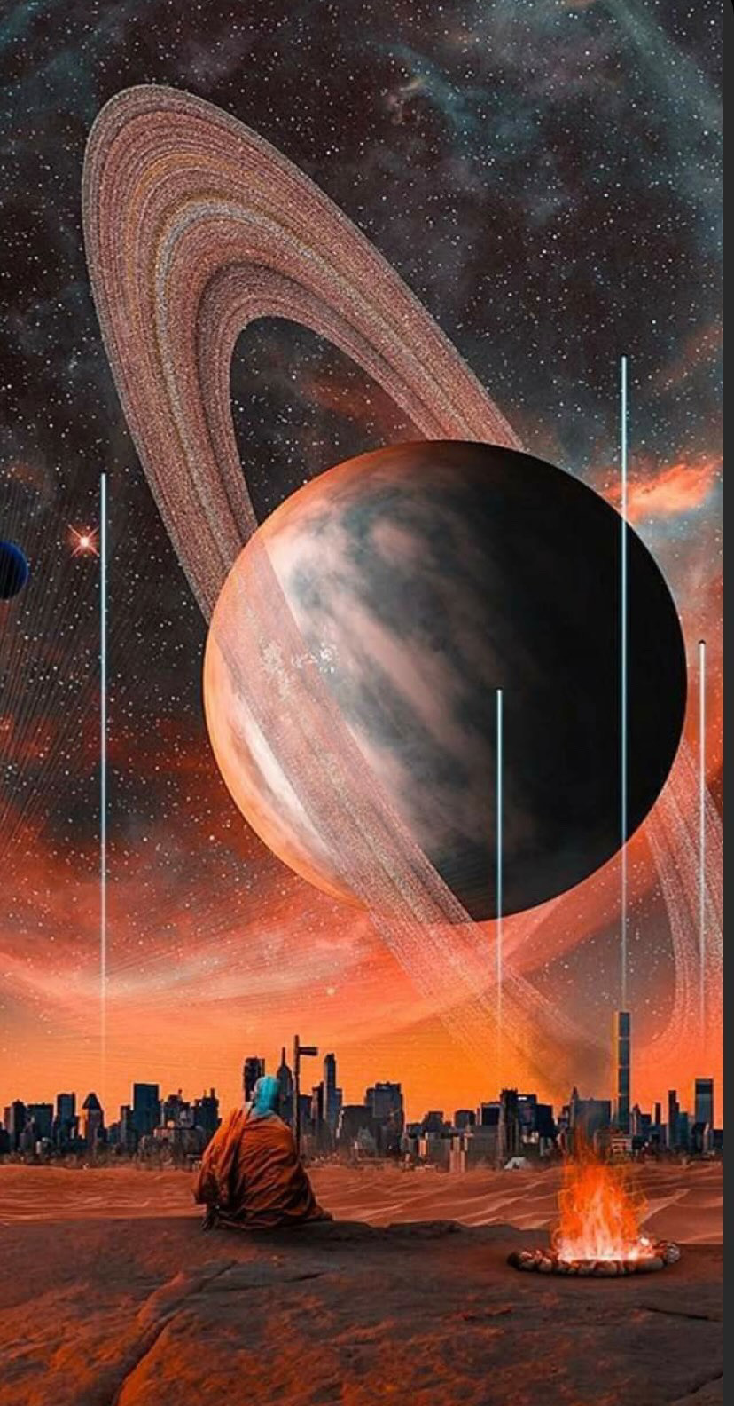
mysterious world
enjoy

Slide 2
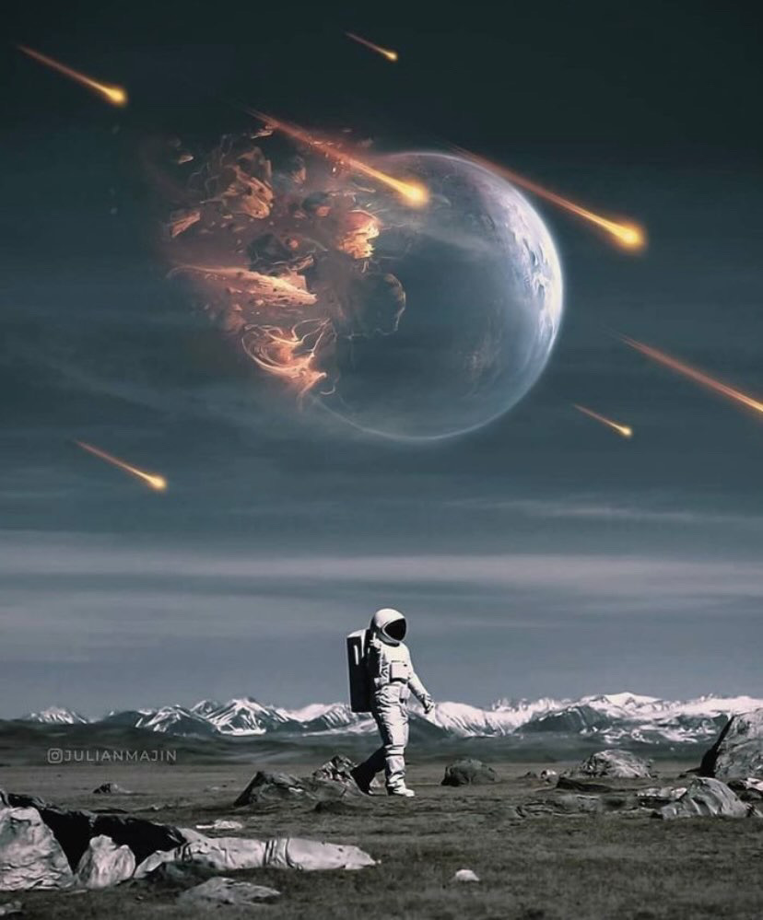
Space is a place that man's mind cannot imagine from its greatness and mystery. Over the years, mankind has tried to unravel this mystery. Despite all these attempts, they have discovered very little of it. One state sent missiles and another sent satellites and another astronaut in order to see what proved their freshness in definitive evidence.

Slide 3
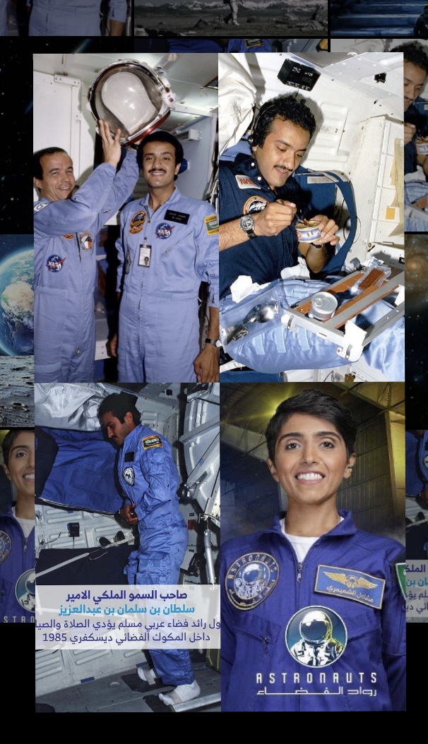
‏Saudi Arabia has been an interested country in this world for more than 35 years when Prince Sultan bin Salman ascended to space in 1985 to be the first Arab Muslim astronaut to be Saudi Prince Sultan bin Salman.Women also have a fingerprint in this field, with “mashaeil shamimiri” representing women and being the first Saudi to join the US space agency NASA, serving as Vice President of the International Astronautical Federation since September 2022 and the first Saudi woman to win this position.🇸🇦🇸🇦

Slide 4
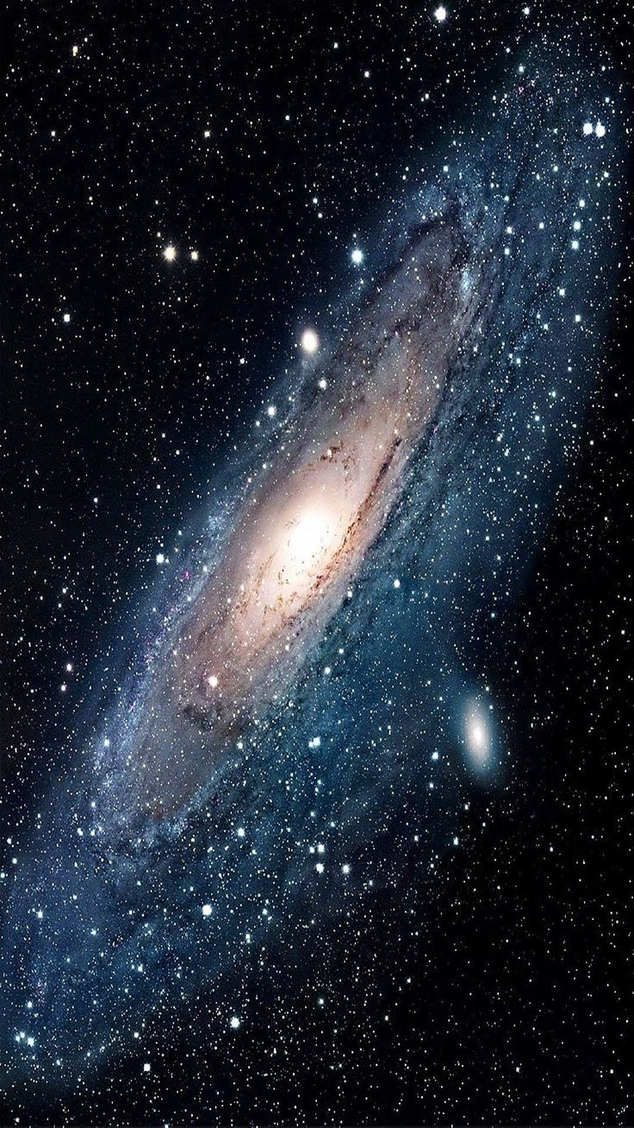
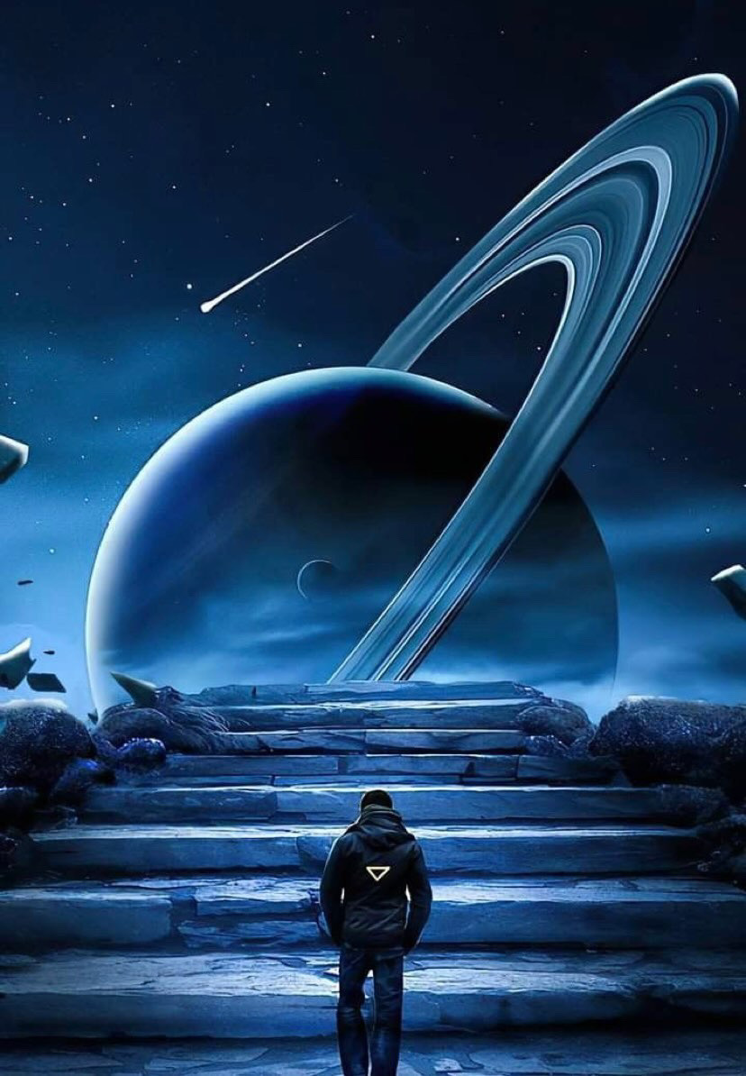
Some theories say that there are living creatures living on the planets that coexist with their rituals, my project partner and I believe in their existence, yes it is uncertain, but there is no evidence to disprove them.

